Slide 1
Data Formats

Slide 2
Learning Objectives
To learn about different file formats that are used for storing and analyzing genomics data sets
To learn variances that exist for specific formats within the constraints of official specifications

Slide 3
Formatting Genomic Information
Bacterial Genomics (and Eukaryotic as well) generates a lot of information that needs to be organized and accessible
This can include how to organize a a complex gene structure or multi-gene family, as well as other features of interest in a genome
There are a plethora of file formats that have been created, however some are much more common.

Slide 4
Gene Annotations
Many different sets of gene annotations
NCBI RefSeq
UCSC Genes
EBI Ensembl
Gencode
Others
Although they are very similar, differences include
inclusion of predicted genes
inclusion of splice variants
omission of genes without mRNA evidence

Slide 5
Generic Feature Format (GFF)
Multi-level annotation to address variations at the same locus
Different versions, GFF3 is most recent
Start position is 1-offset (i.e., starts at ‘1’)
For proteins, levels are gene -> mRNA -> subfeatures (CDS, UTR, exon)
Can also encode many other data types (alignments, ontologies, operons, etc)
#seqid source type start end score strand phase attributes
ctg123 example gene 1050 9000 . + . ID=EDEN;Name=EDEN;Note=protein kinase
ctg123 example mRNA 1050 9000 . + . ID=EDEN.1;Parent=EDEN;Name=EDEN.1;Index=1
ctg123 example five_prime_UTR 1050 1200 . + . Parent=EDEN.1
ctg123 example CDS 1201 1500 . + 0 Parent=EDEN.1
ctg123 example CDS 3000 3902 . + 0 Parent=EDEN.1
ctg123 example CDS 5000 5500 . + 0 Parent=EDEN.1
ctg123 example CDS 7000 7608 . + 0 Parent=EDEN.1
ctg123 example three_prime_UTR 7609 9000 . + . Parent=EDEN.1
ctg123 example mRNA 1050 9000 . + . ID=EDEN.2;Parent=EDEN;Name=EDEN.2;Index=1
ctg123 example five_prime_UTR 1050 1200 . + . Parent=EDEN.2
ctg123 example CDS 1201 1500 . + 0 Parent=EDEN.2
ctg123 example CDS 5000 5500 . + 0 Parent=EDEN.2
ctg123 example CDS 7000 7608 . + 0 Parent=EDEN.2
ctg123 example three_prime_UTR 7609 9000 . + . Parent=EDEN.2
ctg123 example mRNA 1300 9000 . + . ID=EDEN.3;Parent=EDEN;Name=EDEN.3;Index=1
ctg123 example five_prime_UTR 1300 1500 . + . Parent=EDEN.3
ctg123 example five_prime_UTR 3000 3300 . + . Parent=EDEN.3
ctg123 example CDS 3301 3902 . + 0 Parent=EDEN.3
ctg123 example CDS 5000 5500 . + 1 Parent=EDEN.3
ctg123 example CDS 7000 7600 . + 1 Parent=EDEN.3
ctg123 example three_prime_UTR 7601 9000 . + . Parent=EDEN.3
http://gmod.org/wiki/GFF3

Slide 6
Gene Transfer Format (GTF)
An extension to, and backward compatible with, GFF2
The first 8 GTF fields are the same as GFF
The feature field is the same as GFF, but also includes optional values 5UTR, 3UTR, inter, inter_CNS, and intron_CNS
The group field has been expanded into a list of attributes, in type/value pairs. Attributes must end in a ‘;’ and be separated from each other by exactly 1 space
381 Twinscan CDS 380 401 . + 0 gene_id "001"; transcript_id "001.1";
381 Twinscan CDS 501 650 . + 2 gene_id "001"; transcript_id "001.1";
381 Twinscan CDS 700 707 . + 2 gene_id "001"; transcript_id "001.1";
381 Twinscan start_codon 380 382 . + 0 gene_id "001"; transcript_id "001.1";
381 Twinscan stop_codon 708 710 . + 0 gene_id "001"; transcript_id "001.1";
http://mblab.wustl.edu/GTF22.html

Slide 7
Browser Extensible Data (BED) format
Tab-delimited file specifically designed for coordinate based data storage
3 required columns (chrom, chromStart, chromEnd)
chromStart is 0-offset (starts at ‘0’), chromEnd is 1-based
9 additional optional fields:
name, score, strand, thickStart, thickEnd, itemRgb, blockCount, blockSizes, blockStarts
browser position chr7:127471196-127495720
browser hide all
track name="ItemRGBDemo" description="Item RGB demonstration" visibility=2 itemRgb="On"
chr7 127471196 127472363 Pos1 0 + 127471196 127472363 255,0,0
chr7 127472363 127473530 Pos2 0 + 127472363 127473530 255,0,0
chr7 127473530 127474697 Pos3 0 + 127473530 127474697 255,0,0
chr7 127474697 127475864 Pos4 0 + 127474697 127475864 255,0,0
chr7 127475864 127477031 Neg1 0 - 127475864 127477031 0,0,255
chr7 127477031 127478198 Neg2 0 - 127477031 127478198 0,0,255
chr7 127478198 127479365 Neg3 0 - 127478198 127479365 0,0,255
chr7 127479365 127480532 Pos5 0 + 127479365 127480532 255,0,0
chr7 127480532 127481699 Neg4 0 - 127480532 127481699 0,0,255
https://genome.ucsc.edu/FAQ/FAQformat.html#format1

Slide 8
Reference Sequence Formats
Typically in FASTA format:
header line beginning with “>” symbol
1 or more sequence lines
Can be indexed for random access using a variety of means
Common software includes samtools http://samtools.sourceforge.net/
Index: samtools faidx chr1.fa
FASTA from region: samtools faidx chr1.fa chr1:72352323-72354352

Slide 9
FASTA Format
Can be used for both DNA and proteins (though not in the same file)
No specific format required on header line, however different resources (e.g. GenBank) use consistent formats that can be parsable within the context of that resource
Quality scores for each base or amino acid typically stored in another file
>NC_000001.11 Homo sapiens chromosome 1, GRCh38.p13 Primary Assembly
TATTAAACAGAGAGTCTGTAAGCACTTAGAAAAGGCCGCGGTGAGTCCCAGGGGCCAGCACTGCTCGAAA
TGTACAGCATTTCTCTTTGTAACAGGATTATTAGCCTGCTGTGCCCGGGGAAAACATGCAGCACAGTGCA
TCTCGAGTCAGCAGGATTTTGACGGCTTCTAACAAAATCTTGTAGACAAGATGGAGCTATGGGGGTTGGA
GGAGAGAACATATAGGAAAAATCAGAGCCAAATGAACCACAGCCCCAAAGGGCACAGTTGAACAATGGAC
TGATTCCAGCCTTGCACGGAGGGATCTGGCAGAGTCCATCCAGTTCATTCAACACCTGGTTAGAAAACTG
GGGCCAGCACACAGGGGAAGGGTAAGCTGGTTTCATGATCGAATCAAGGCTCAGACAATTTTTAAAGGCC
AGAGGGTAGACTGCAATCACCAAGATGAAATTTACAAGGAACAAATGTGAAGCCCAACATTTAGGTTTTA
AAAATCAAGCGTATAAATACAGAAGGTGGAGGGAACTTGCTTTAGACACAGTTCAGGTGAAGAAAGACCT
GGAAACTTCTGTTAACTATAAGCTCAGTAGGGGCTAAAAGCATGTTAATCGGCATAAAAAGGCAATGAGA
TCTTAGGGCACACAGCTCCCCGCCCCTCTTCTGCCCTTCATCCTTCTTTCAATCAGCAGGGACCGTGCAC
TCTCTTGGAGCCACCACAGAAAACAGAGGTGCATCCAGCACCACAGAAAACAGAGCCACCACAGAAAACA
>MCHU - Calmodulin - Human, rabbit, bovine, rat, and chicken
ADQLTEEQIAEFKEAFSLFDKDGDGTITTKELGTVMRSLGQNPTEAELQDMINEVDADGNGTIDFPEFLT
MMARKMKDTDSEEEIREAFRVFDKDGNGYISAAELRHVMTNLGEKLTDEEVDEMIREADIDGDGQVNYEE
FVQMMTAK*
>gi|5524211|gb|AAD44166.1| cytochrome b [Elephas maximus maximus]
LCLYTHIGRNIYYGSYLYSETWNTGIMLLLITMATAFMGYVLPWGQMSFWGATVITNLFSAIPYIGTNLV
EWIWGGFSVDKATLNRFFAFHFILPFTMVALAGVHLTFLHETGSNNPLGLTSDSDKIPFHPYYTIKDFLG
LLILILLLLLLALLSPDMLGDPDNHMPADPLNTPLHIKPEWYFLFAYAILRSVPNKLGGVLALFLSIVIL
GLMPFLHTSKHRSMMLRPLSQALFWTLTMDLLTLTWIGSQPVEYPYTIIGQMASILYFSIILAFLPIAGX
IENY
https://en.wikipedia.org/wiki/FASTA_format

Slide 10
FASTQ Format
More modern format for storing sequence data
Quality scores are stored as additional rows in the sequence record
@SEQ_ID
GATTTGGGGTTCAAAGCAGTATCGATCAAATAGTAAATCCATTTGTTCAACTCACAGTTT
+
!''*((((***+))%%%++)(%%%%).1***-+*''))**55CCF>>>>>>CCCCCCC65
A FASTQ file normally uses four lines per sequence.
Line 1 begins with a '@' character and is followed by a sequence identifier and an optional description (like a FASTA title line).
Line 2 is the raw sequence letters.
Line 3 begins with a '+' character and is optionally followed by the same sequence identifier (and any description) again.
Line 4 encodes the quality values for the sequence in Line 2, and must contain the same number of symbols as letters in the sequence.
https://en.wikipedia.org/wiki/FASTQ_format

Slide 11
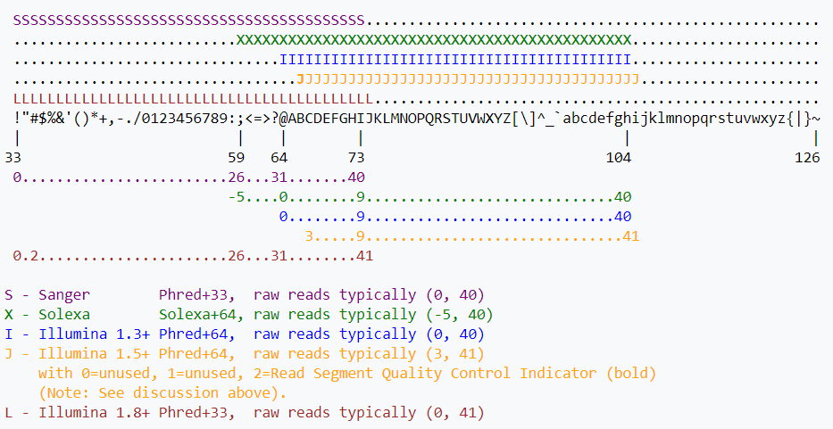
FASTQ Format – Quality Scores
Quality scores are represented by a single ASCII character
Values are determined based on an offset from the characters integer value
This has differed historically among platforms, but is now consistently +33
https://en.wikipedia.org/wiki/FASTQ_format

